Slide 1
Smart Watch Progress Report 3
Derek Tan, Julian Nguyen, Eddie Ryan

Slide 2
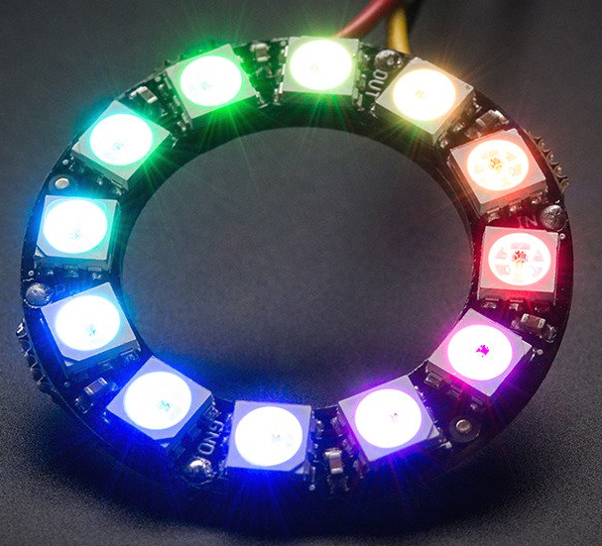
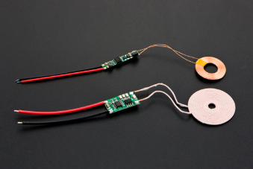
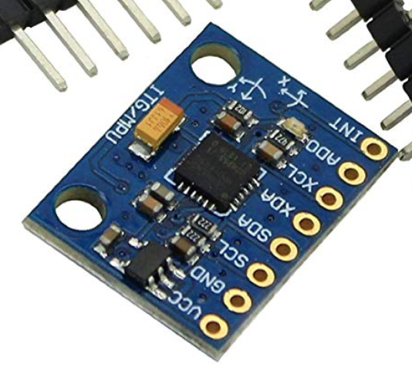
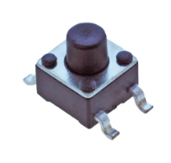
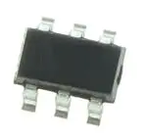
Parts Research
PLA Plastic
Battery/Charging System
LED Display
Pushbutton
Battery Protector
Bluetooth module

Slide 3

MultiSim

Slide 4
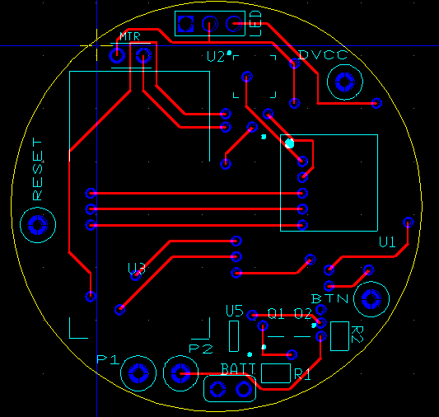
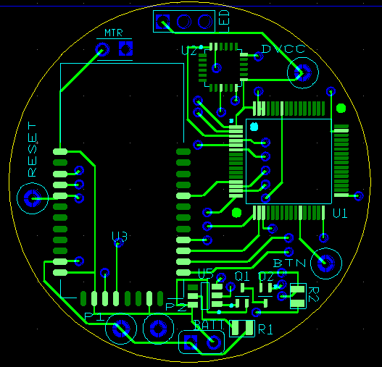
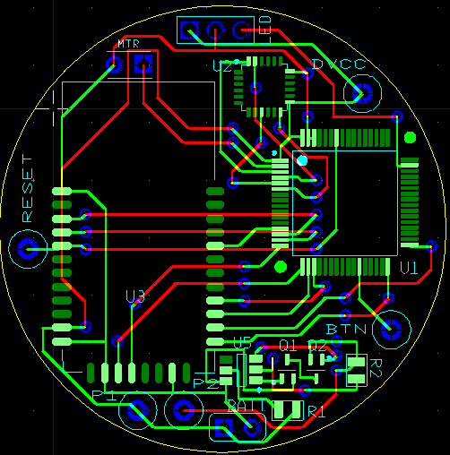
Ultiboard

